Slide 1
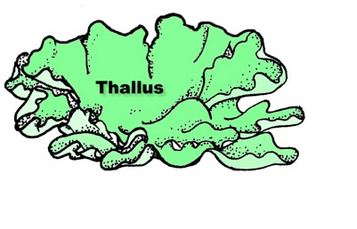
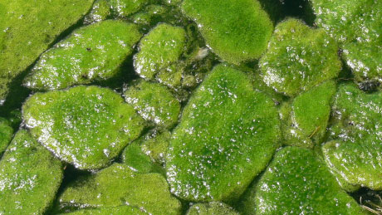
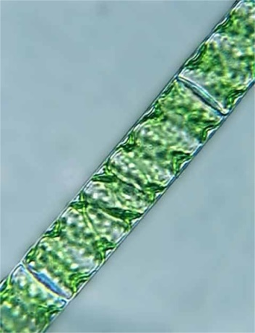
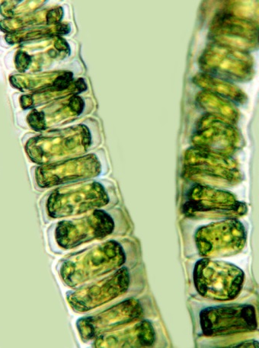
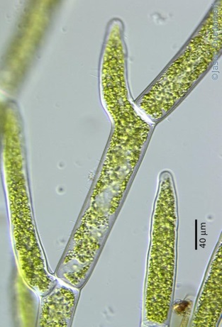
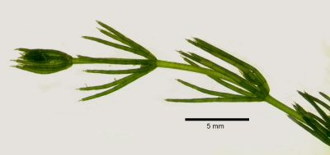
Thallophyta
Plants that do not have well-differentiated body design fall in this group.
The plant body is not differentiated into roots, stem and leaves.
The plants in this group are commonly called algae.
These plants are predominantly aquatic.
Examples are Spirogyra, Ulothrix, Cladophora and Chara

Slide 2

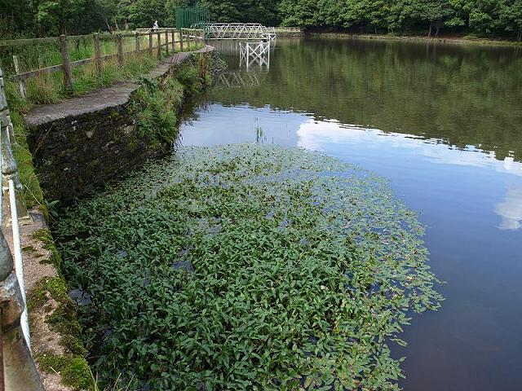
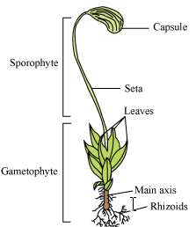
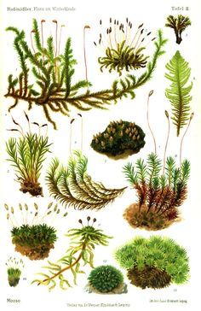
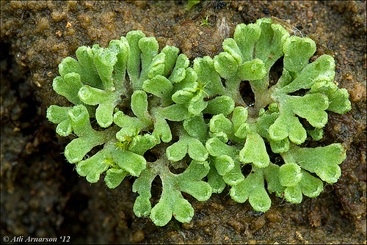
Bryophyta
These are called the amphibians of the plant kingdom.
The plant body is commonly differentiated to form stem and leaf-like structures.
However, there is no specialised tissue for the conduction of water and other substances from one part of the plant body to another.
Examples are moss (Funaria) and Marchantia

